Slide 1
Chapter 36: Image Formation
Reading assignment: Chapter 36
Homework 36.1 (Friday, May 3, only the first seven problems, plane and concave mirror): OQ2, OQ6, 1, 2, 8, 9, 10 ); rest of the problems (convex mirror) is extra credit: 11, 13, 18, 22, 25
Homework 36.2: (not due): OQ4, OQ5, OQ7, OQ12, CQ11, 38, 39, 41, 43, 45, 46, 53, 57, 58, 59
In this chapter, we will investigate and analyze how images can be formed by reflection and refraction. Using mostly ray tracing, we will determine image size and location.
Images formed by reflection:
  Flat mirror, concave mirror, convex mirror
Images formed by refraction:
  Convex lens, concave lens
Lens aberrations
  Spherical aberration, chromatic aberration
Lens combinations and some optics instruments
  Eye, microscope

Slide 2
Summer Session Registration (Mar 18 – May 31)
Please spread the word!
Summer 1 | PHY 110 | May 29-Jul 3 | MTWRF 9:30-1:00 | Dr. Bin He
Summer 1 | PHY 113 | May 29-Jul 3 | MTWRF 8:30-12:30 | Dr. Jack Dostal
Summer 2 | PHY 113 | Jul 8-Aug 10 | MTWRF 9:30-1:30 | Dr. Bin He
Summer 2 | PHY 114 | Jul 8-Aug 10 | MTWRF 8:30-12:30 | Dr. Burak Ucer

Slide 3
Announcements
Final exam is scheduled for
  Friday, May 10, 9:00 am – 12:00 pm, Olin 101 (class room).
  Early date: Tuesday, May 7, 9:00 am – 12:00 pm, Olin 101 (class room).
Final exam will be comprehensive:
  Chapters 23 – 29, partial 34 (EM waves, c, E, B perpendicular), 35, (partial) 36, not 37 & 38 (diffraction)
Review on Thursday, May 9, 5:00 pm – 7:00 pm, Olin 101 (class room)
I’ll send out equation sheet
Webpage will be updated (all ppt slides, all scores, etc)
Thanks for being a wonderful class!!
Best of luck to all of you!!

Slide 4
Summary of Geometric Optics Rules
Object distances, p, are typically positive (except e.g., cases of multiple lenses or mirrors with an image on the far side of a lens, or a virtual object behind mirror).
Image distances, q, are positive for real images and negative for virtual images.
Real images form on the same side of the object for mirrors and on the opposite side for refracting surfaces (lenses). Virtual images form on the opposite side of the object for mirrors and on the same side for refracting surfaces.
When an object faces a convex mirror or concave refracting surface the radius of curvature, R, is negative. When an object faces a concave mirror or convex refracting surface the radius of curvature is positive.
Device | Object location | Image location | Image type | Image orientation | Sign of f | Sign of R | Sign of q | Sign of m
Plane mirror | anywhere | opposite object | virtual | same as object | f = ∞ | ∞ | negative | = +1
Concave mirror | outside f | same | real | inverted | positive | positive | positive | negative
Concave mirror | inside f | opposite | virtual | same | positive | positive | negative | positive
Convex mirror | anywhere | opposite | virtual | same | negative | negative | negative | positive
Converging lens | outside f | opposite | real | inverted | positive | positive | positive | negative
Converging lens | inside f | same | virtual | same | positive | positive | negative | positive
Diverging lens | anywhere | same | virtual | same | negative | negative | negative | positive

Slide 5

Images
We will continue to use the ray approximation of light; → light travels in straight line paths called light rays.
When we see an object, according to the ray model, light reaches our eyes from each point of an object.
Light rays leave each point of an object in all directions, only a small bundle of these can enter an observers eye, who will then interpret these as an image.
Your eyes tell you where/how big an object/image is.
Mirrors and lenses can ‘fool’ your eyes; that is, create images that are bigger or smaller than the original object; images that are upright or inverted as compared to the original object; and images that are in different places than the original object.

Slide 6
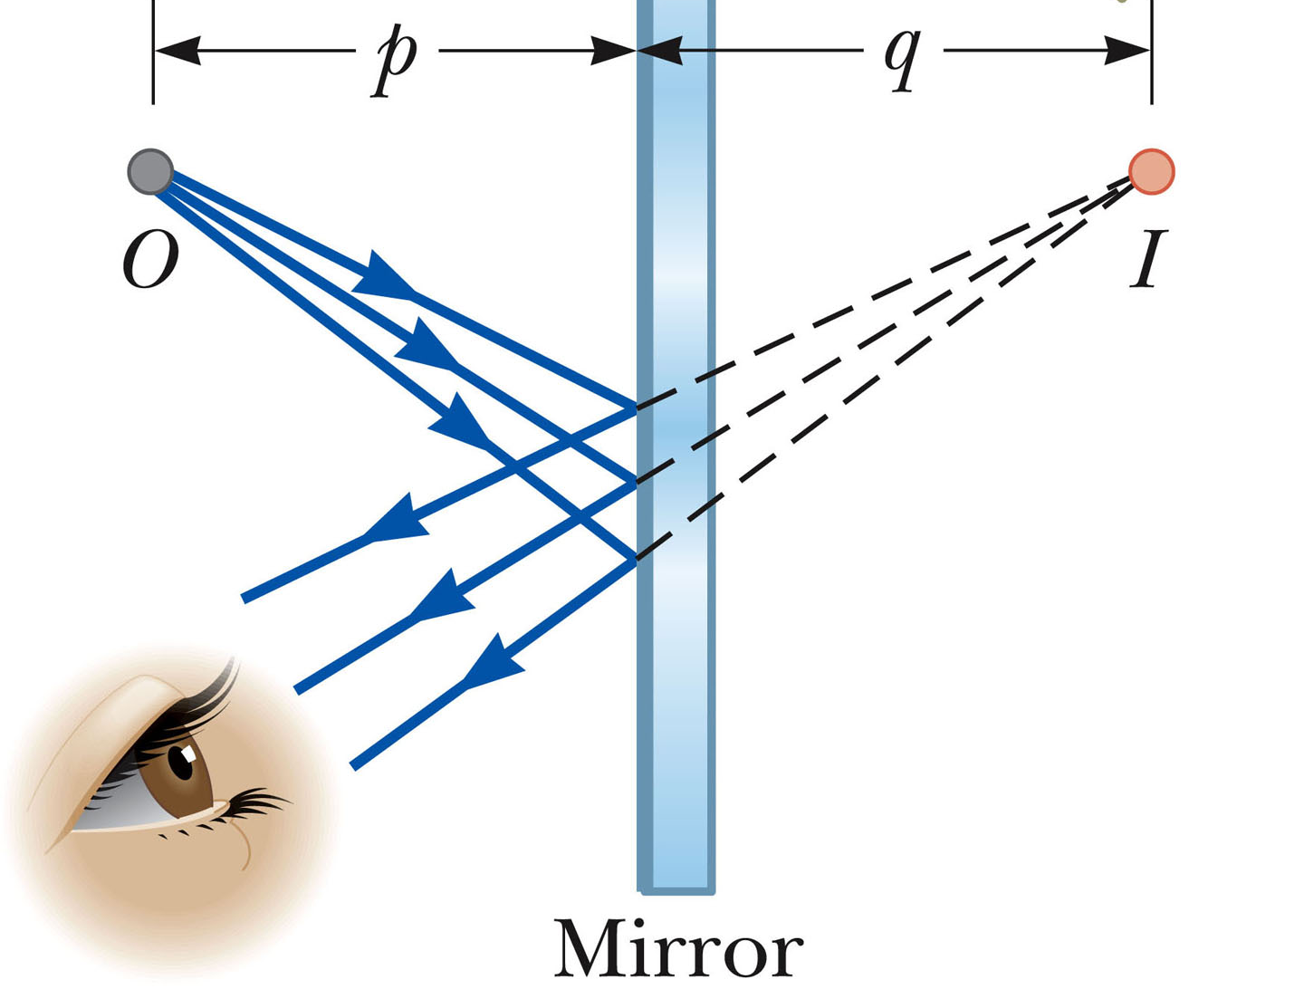
Case 1: Flat mirror
Images formed by flat mirror
Place a point light source P (object O) in front of a mirror.
If you look in the mirror, you will see the object as if it were at the point P’, behind the mirror.
As far as you can tell, there is a “mirror image” behind the mirror.
For an extended object, you get an extended image.
The distances of the object
from the mirror and the image
from the mirror are equal.
Flat mirrors are the only
perfect image system
(no distortion).
P’
P
Object
Image
Mirror
p
q

Slide 7
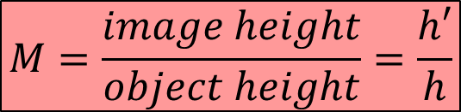
Image Characteristics and Definitions
h
h’
p
q
Object
Image
Mirror
The front of a mirror or lens is the side the light goes in.
Object distance, p, is how far the object is in front of the mirror.
Image distance, q, is how far the image is in front* of the mirror (*behind for lenses).
    Real image if q > 0, virtual image if q < 0 (more on that in a bit).
Magnification, M, is how large the image is compared to the object.
$$M=\frac{image height}{object height}=\frac{h′}{h}$$
                Upright if positive
                Inverted if negative

Slide 8
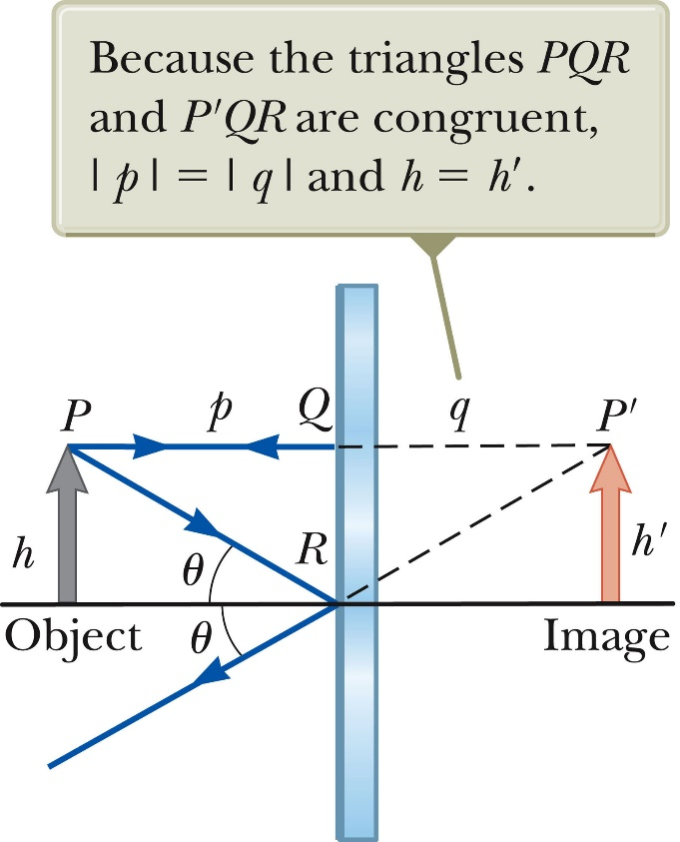
Real and virtual image
Virtual image
Light rays don’t pass through the virtual image. Rays only seem to come from the virtual image.
Real image (more on that later)
Light rays actually pass through the real image.
A real image can be captured on a piece of paper or film placed at the image location.
A flat mirror forms a virtual, upright image with magnification 1
Both, real and virtual images can be seen by the eye.

Slide 9
Case 1: Flat mirror
White board example
How tall must a full-length mirror be?
A 1.80 m tall man stands in front of a vertical, plane mirror.
What is the minimum height of the mirror and how high must its lower edge be above the floor for him be able to see his whole body? Assume his eyes are 10 cm below the top of his head.
Does moving toward or away from the mirror change this?
1.70 m
θ
θ’

Slide 10
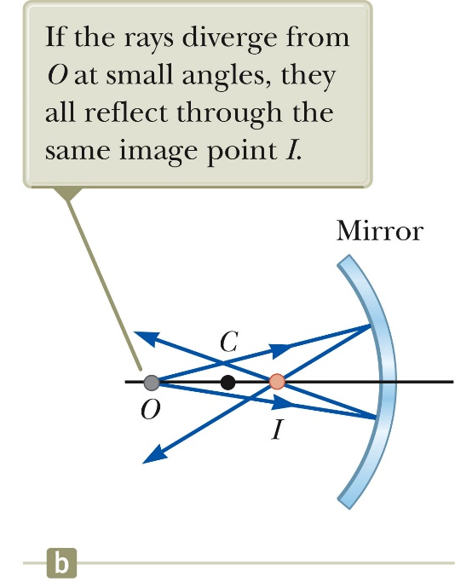

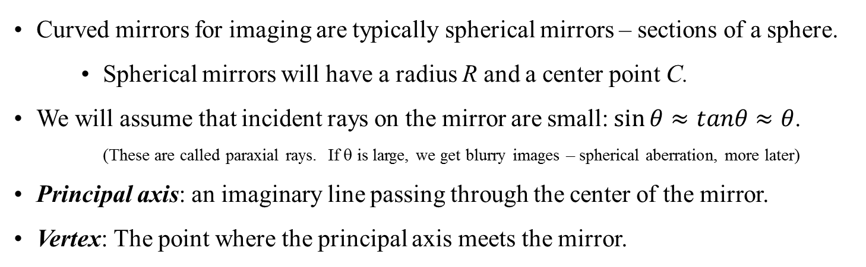
Case 2: Spherical mirrors
Spherical Mirrors
Concave mirrors
Curved mirrors for imaging are typically spherical mirrors – sections of a sphere.
    Spherical mirrors will have a radius R and a center point C.
We will assume that incident rays on the mirror are small: $\sin{θ≈tanθ≈θ}$.
(These are called paraxial rays. If θ is large, we get blurry images – spherical aberration, more later)
Principal axis: an imaginary line passing through the center of the mirror.
Vertex: The point where the principal axis meets the mirror.

Slide 11
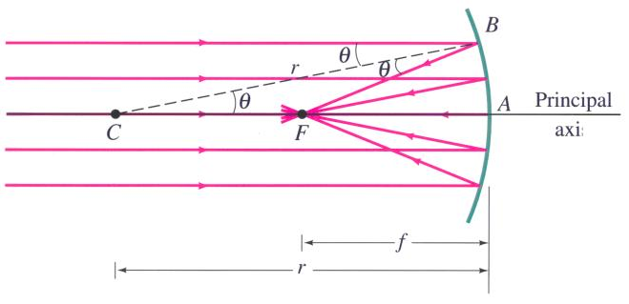
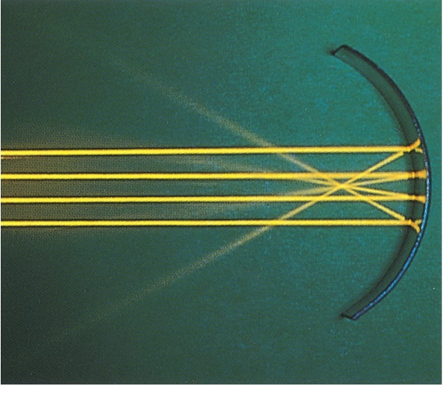
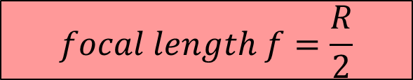
Case 2: Spherical mirrors
Spherical Mirrors
Concave mirror, focal length
Incoming parallel rays are reflected and focused at the focal point, F.
f is called the focal length of the mirror (distance from F to mirror).
R
V
R
For a spherical mirror:
$$focal length f=\frac{R}{2}$$

Slide 12
Spherical Mirrors
Concave mirrors
Case 2.1: Concave mirror, object outside f, outside C
Ray tracing and creating an image
(We get an image were the rays converge. Typically only two rays are needed, use third ray to check)
Any ray coming in parallel goes through the focus
Any ray through the focal point, F, comes out parallel
Any ray through the center, C, comes straight back
Let’s use these rules to find the image for an object outside the focal point:
Object
h
F
C
h’
Image
p
q

Slide 13
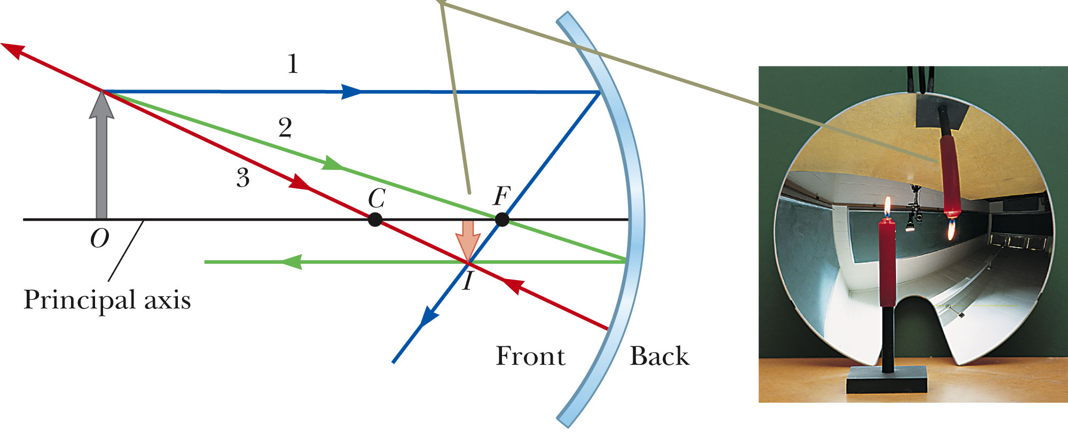
Spherical Mirrors
Case 2.1: Concave mirror, object outside f, outside C
Any ray coming in parallel goes through the focus
Any ray through the focal point, F, comes out parallel
Any ray through the center, C, comes straight back
Ray tracing and creating an image
When the object is out further than the center point, the image is real, inverted and reduced in size.
p
q

Slide 14
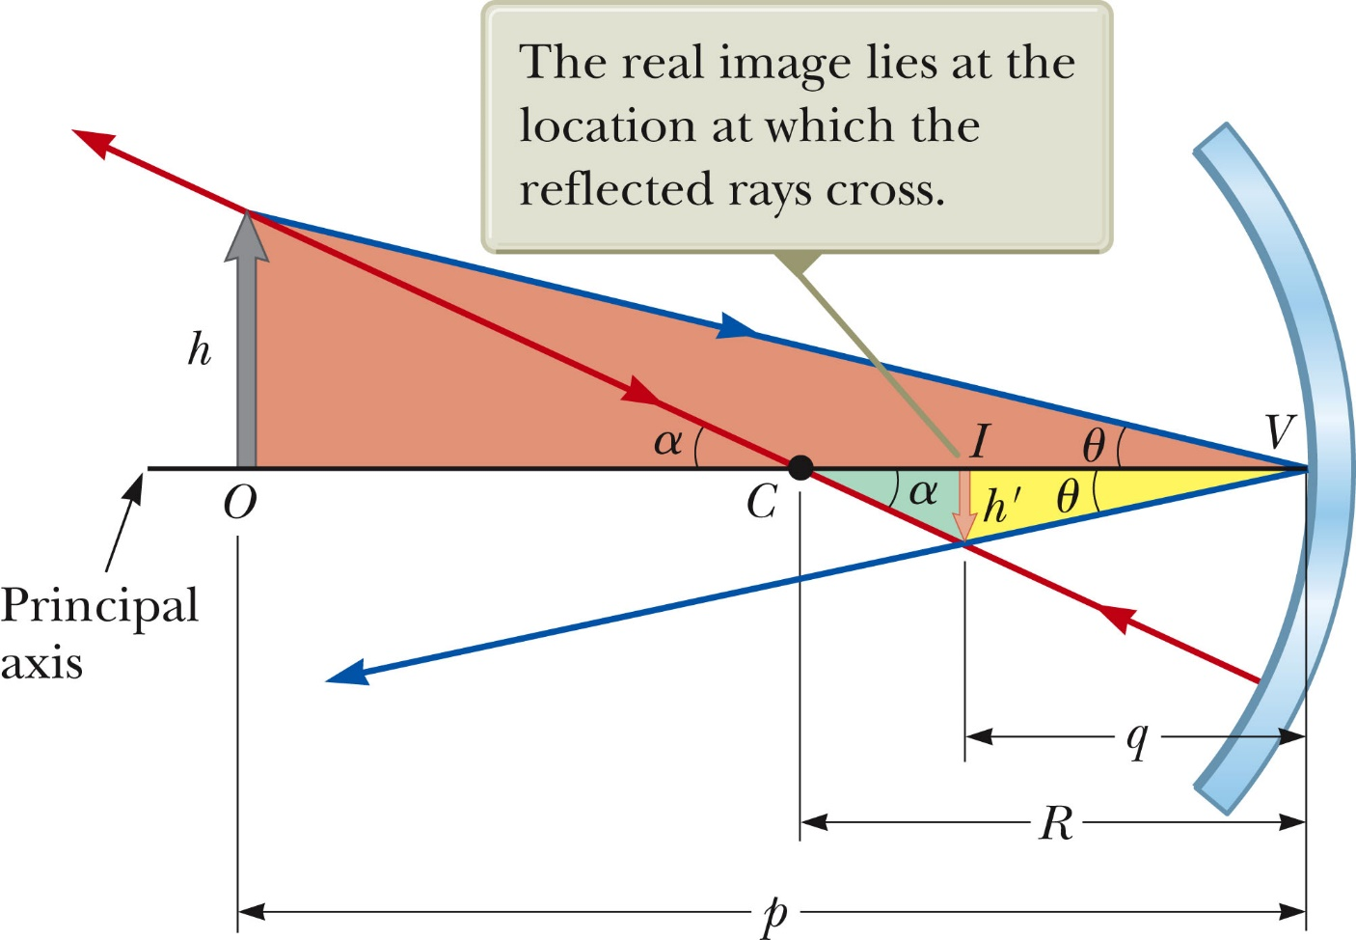
The mirror equation
These equations are true for all concave and convex mirrors
(Be careful with signs!!)

Slide 15
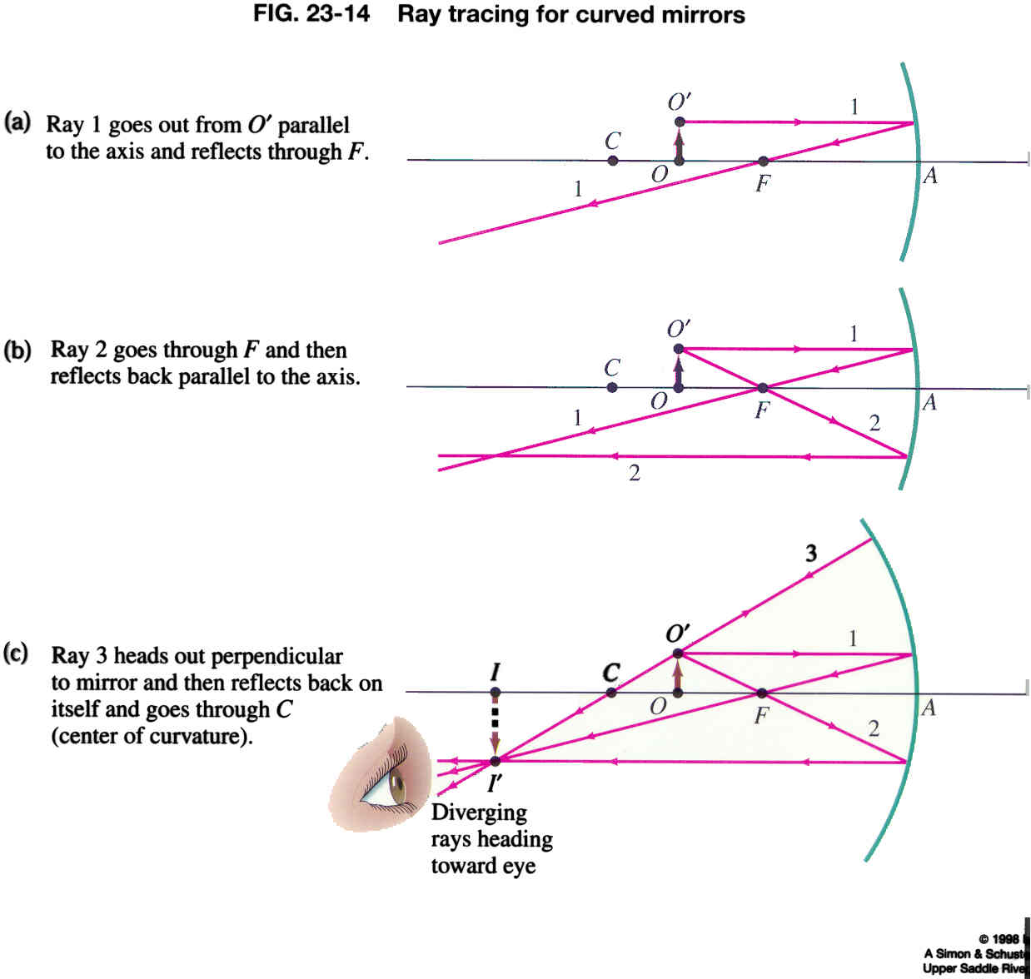
Spherical Mirrors
Case 2.2: Concave mirror, object outside f, inside C
How about putting the object between the center point and the focal point?
When the object is between the center point and the focal point, the image is real, inverted and increased in size.

Slide 16
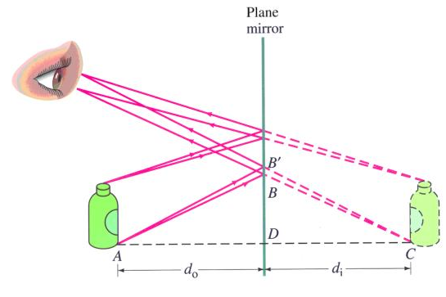
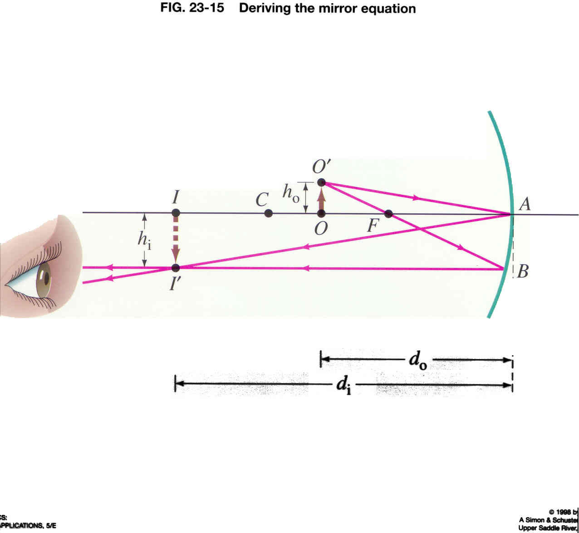
Virtual vs. real image
Virtual image.
Our light rays don’t pass through the virtual image. Rays only seem to come from the virtual image.
Virtual image
p
q
Real image.
Our light rays actually pass through the real image.
A real image will appear on a piece of paper or film placed at the image location.
Real image
p
q

Slide 17
Case 2.2: Concave mirror, object outside f, inside C
White board example
Application of the mirror equation. Image in a concave mirror.
A 1.5 cm high diamond ring is placed 20.00 cm from a concave mirror whose radius of curvature is 30.0cm. Determine
The position of the image
The size of the diamond in the image.

Slide 18
i-clicker
h_{i}
h_{o}
If the object in the previous figure is placed instead where the image is, where will the new image be?
20 cm
30 cm
40 cm
50 cm
60 cm
Mirror equation is symmetric in p and q. Thus, the new image will be where the old object was.

Slide 19
Spherical Mirrors: Ray Tracing
Case 3: Concave mirror, object between F and mirror
Any ray coming in parallel goes through the focus
Any ray through the focus comes out parallel
Any ray through the center comes straight back
Do it again, but a bit harder (for an object inside the focal point)
A ray through the center won’t hit the mirror
So pretend it comes from the center
Similarly for ray through focus
Trace back to see where they came from
F
P
C

Slide 20
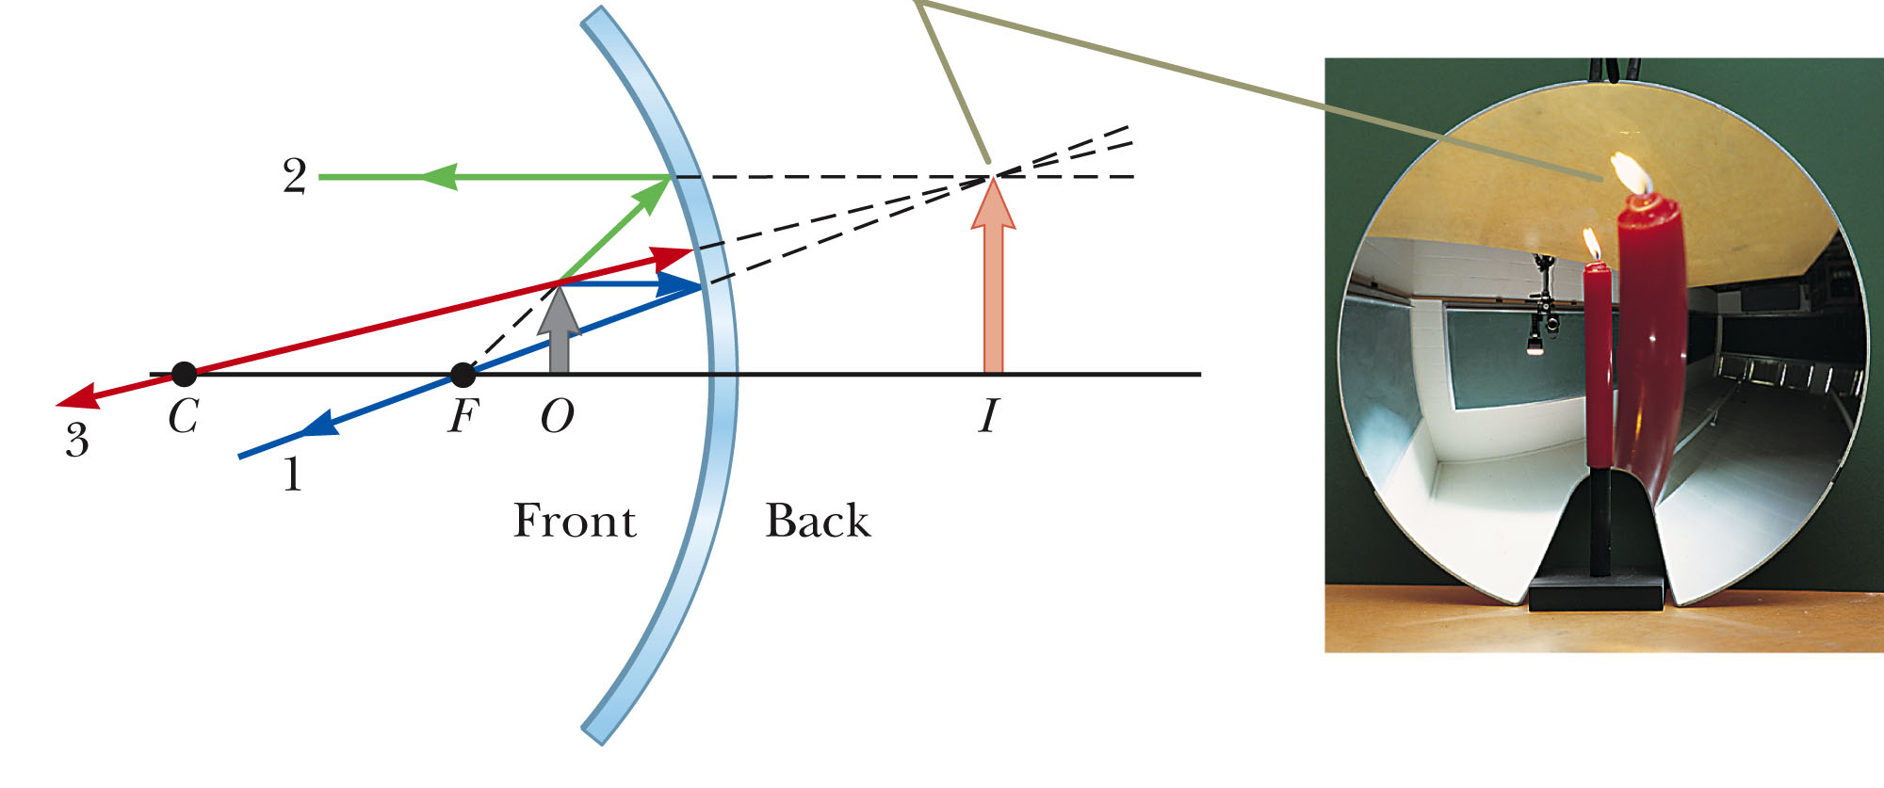
Spherical Mirrors
Case 3: Concave mirror, object between F and mirror
Any ray coming in parallel goes through the focus
Any ray through the focal point, F, comes out parallel
Any ray through the center, C, comes straight back
Ray tracing and creating an image
When the object is closer than the focal point, the image is virtual, upright and increased in size.
p
q

Slide 21
White board example
Case 3: Concave mirror, object between F and mirror
Object closer than focal point to concave mirror.
A 1.00 cm object is placed 10.0 cm from a concave mirror whose radius of curvature is 30.0 cm.
Draw a ray diagram to locate (approximately) the position of the image.
Determine the position of the image and the magnification analytically.
Is this a real or virtual image?

Slide 22
Spherical Mirrors
Convex mirrors
Case 4: Convex mirror, object anywhere
Up until now, we’ve assumed the mirror is concave – hollow on the side the light goes in (like a cave).
A convex mirror sticks out on the side the light goes in
The formulas still work, but just treat R as negative (thus, f is also negative)
The focus, this time, will be on the other side of the mirror
Ray tracing still works
The image will be virtual and upright.
F
C

Slide 23
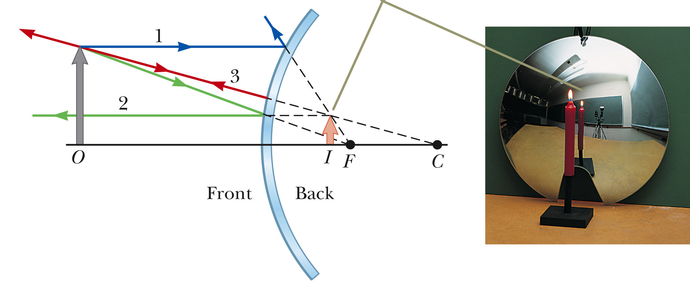
Spherical Mirrors
Convex mirrors
Case 4: Convex mirror, object anywhere
Any ray coming in parallel goes through the focus
Any ray through the focal point, F, comes out parallel
Any ray through the center, C, comes straight back
Ray tracing and creating an image
When the object is in front of a convex mirror, the images is always virtual, upright and reduced in size.

Slide 24

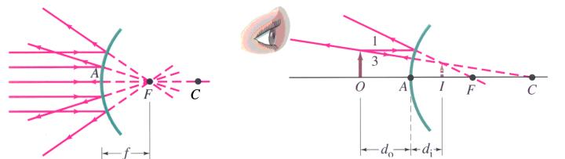
White board example
Case 4: Convex mirror, object anywhere
Convex rear view mirror.
A convex rearview car mirror has a radius of curvature of 40.0 cm.
Determine the location of the image and its magnification for an object 10.0 m from the mirror
How big would a truck that is 3 m high appear in the image?
p
q

Slide 25
i-clicker and white board problem
Light from the Andromeda Galaxy (2 million light years away) reflects off a concave mirror with radius R = 1.00 m. Where does the image form?
A) At infinity B) At the mirror
C) 50 cm in front of mirror D) 50 cm behind of mirror
A spherical mirror is to be used to form, on a screen located 5 m from the object, an image 5 times the size of the object.
Describe the type of mirror required (concave or convex).
Where should the mirror be placed relative to the object?
What is the required radius of curvature of the mirror?
5 m
p
q

Slide 26
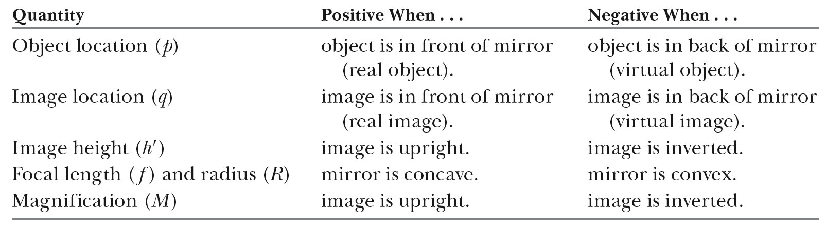
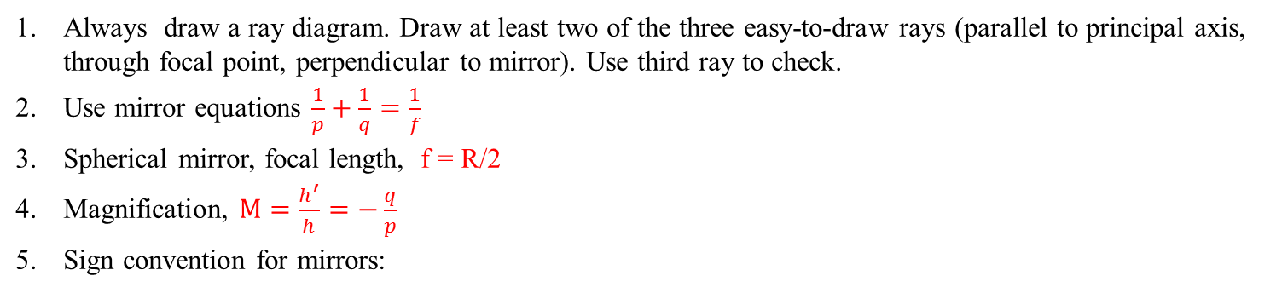
Plane & spherical mirrors: Summary, formulas and conventions
Always draw a ray diagram. Draw at least two of the three easy-to-draw rays (parallel to principal axis, through focal point, perpendicular to mirror). Use third ray to check.
Use mirror equations $\frac{1}{p}+\frac{1}{q}=\frac{1}{f}$
Spherical mirror, focal length, f = R/2
Magnification, $M=\frac{h^{′}}{h}=−\frac{q}{p}$
Sign convention for mirrors:
Device | Object location | Image location | Image type | Image orientation | Sign of f | Sign of R | Sign of q | Sign of m
Plane mirror | anywhere | opposite object | virtual | same as object | f = ∞ | ∞ | negative | = +1
Concave mirror | outside f | same | real | inverted | positive | positive | positive | negative
Concave mirror | inside f | opposite | virtual | same | positive | positive | negative | positive
Convex mirror | anywhere | opposite | virtual | same | negative | negative | negative | positive

Slide 27
Images formed by thin lenses

Slide 28
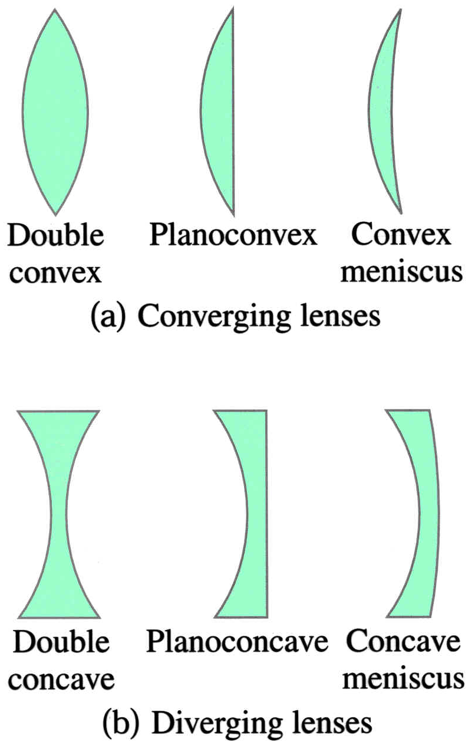
Thin lenses
Types of lenses:
Lenses are very important optical devices.
Lenses form images of objects.
Used in glasses, cameras, telescopes, binoculars, microscopes, …
We will only use ‘thin’ lenses (thickness is less than radius of curvature);
  → simpler formulas
  → simpler ray tracing
  → one line of refraction, rather than two refractive interfaces

Slide 29
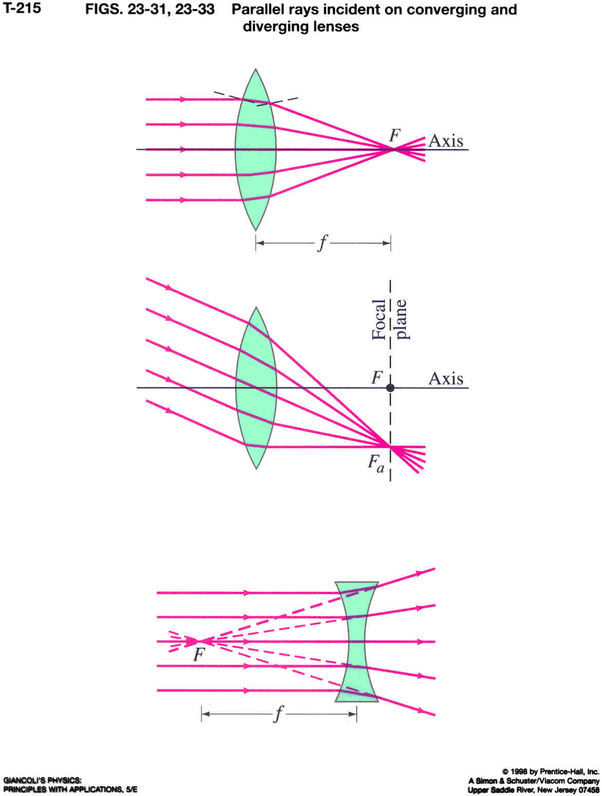
Thin lenses
Focal length
Parallel rays incident on thin lenses
Converging lens
Light rays get refracted by lens (refractive index is higher than surrounding medium)
If the rays fall parallel to the principal axis (object at infinity), they will be focused in the focal point.
focal length, f
Notice that lenses have a focal point on both sides of the lens
Focal length is the same on both sides, even if lens is not symmetric.
normal
Parallel rays coming in at an angle focus on the focal plane

Slide 30
Thin lenses
Focal length
Parallel rays incident on converging and diverging lenses:
Lenses that are thicker in the center than at the edges will make parallel rays converge to a point and they are called a converging lenses.
Lenses that are thinner in the center are called diverging lenses, because they make parallel rays diverge.
Focal point of diverging lens: Point were diverging rays seem to be coming from.
Focal length, f.
f is positive for converging (convex lens)
f is negative for diverging (concave lens)

Slide 31
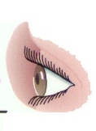
Ray tracing for thin converging lens to find the image created by the lens
Case 5: Converging lens, object farther than focal point
Unlike mirrors, lenses have two foci, one on each side of the lens
Three rays are easy to trace:
Any ray coming in parallel goes through the far focus
Any ray through the near focus comes out parallel
Any ray through the vertex goes straight through
Real image because light rays pass through image
F
F
f
f
Like with mirrors, you sometimes have to imagine a ray coming from a focus instead of going through it
Like with mirrors, you sometimes have to trace outgoing rays backwards to find the image

Slide 32
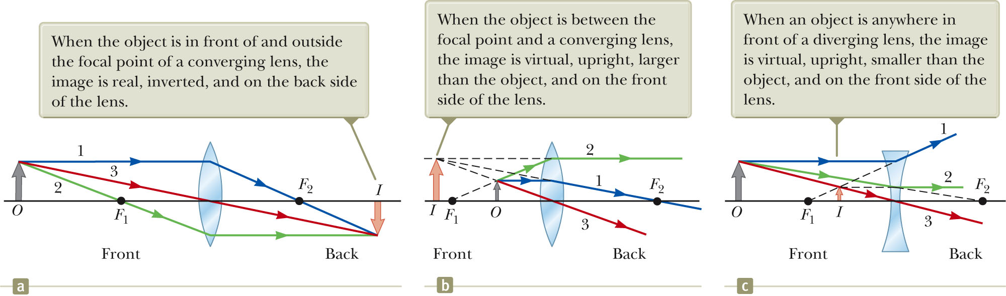
Ray tracing for thin converging lens to find the image created by the lens
Case 6: Converging lens, object closer than focal point
(e.g., magnifying glass)
Case 5: Converging lens, object farther than focal point

Slide 33

Ray tracing for thin diverging lens to find the image created by the lens
Case 7: Diverging lens, object anywhere in front of lens
With a diverging lens, two foci as before, but they are on the ‘wrong’ side; f is negative
Still can do three rays
Any ray coming in parallel comes from the near focus
Any ray going towards the far focus comes out parallel
Any ray through the vertex goes straight through
F
F
f
f
Trace green ray back to see where it came from

Slide 34
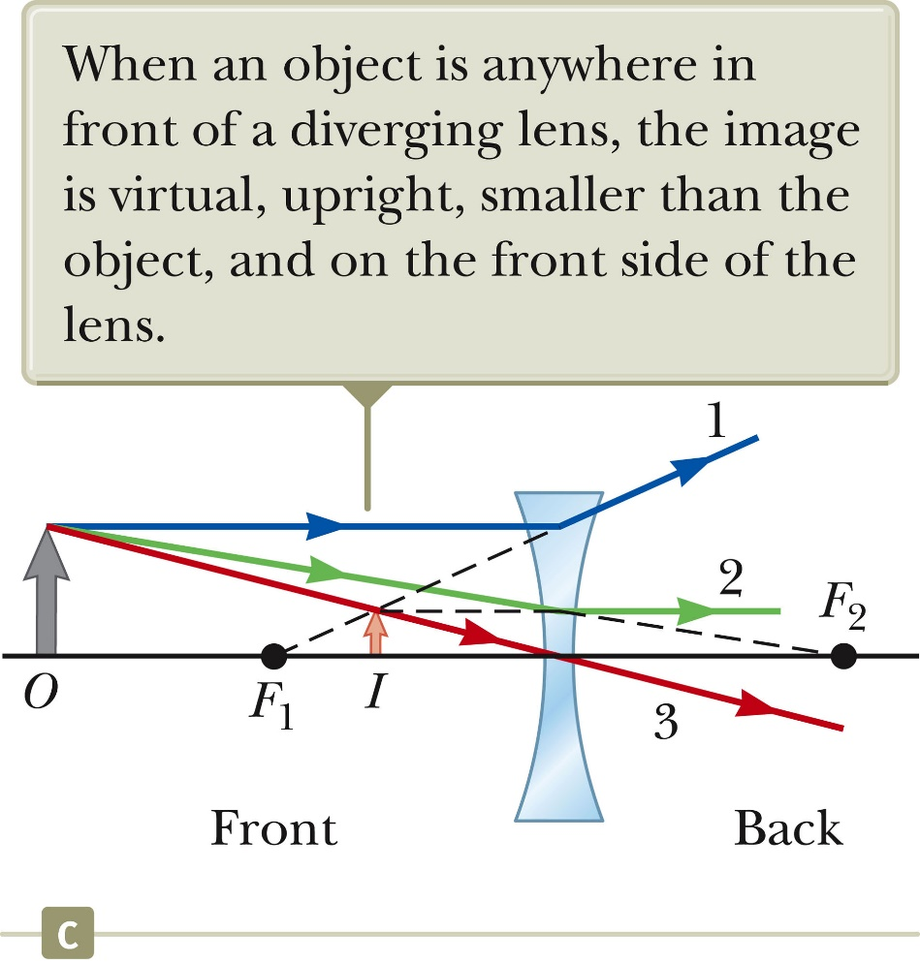
Ray tracing for thin diverging lens to find the image created by the lens
Case 7: Diverging lens, object anywhere in front of lens
The three refracted rays seem to emerge from a point on the left of the lens. This is the image, I.
Because the rays do not pass through the image, it is a virtual image.
The eye does not distinguish between real and virtual images – both are visible.

Slide 35
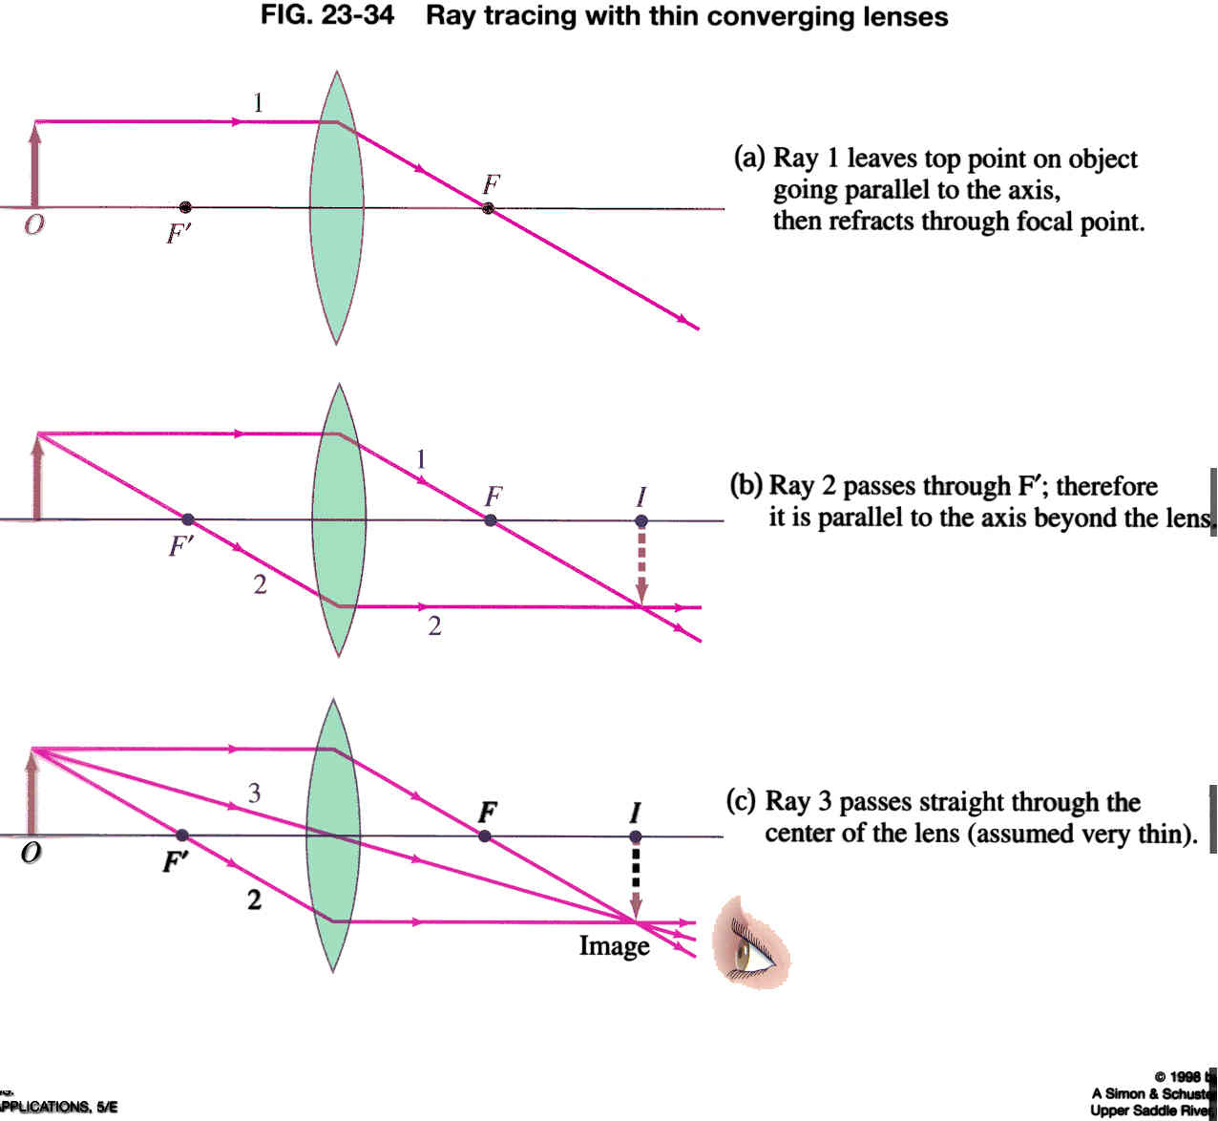
The thin lens equation
h
α
α
h'
h
β
β
h’
f
p
q

Slide 36
Working with thin lens problems
Draw a ray diagram
Solve for unknowns in the lens equation and magnification. Remember reciprocals!
Sign conventions:
The focal length is positive for converging lenses and negative for diverging lenses
The object distance is positive if it is on the side of the lens from which the light is coming, otherwise it is negative.
The image distance, q, is positive if it is on the opposite side of the lens from where the light is coming; if it is on the same side, q is negative. Equivalently, the image distance is positive for a real image and negative for a virtual image.
The height of the image, h’, is positive if the image is upright, and negative if the image is inverted relative to the object (object height, h, is always positive).

Slide 37
White board example
Case 5: Converging lens, object farther than focal point
Image formed by a converging lens.
What is the (a) position and (b) size of the image of a large 7.6 cm high flower placed 1.00 m from a 50.0 mm focal lens camera?
i-clicker: Is this a real or virtual image?
A) Real B) Virtual C) Impossible to tell

Slide 38
White board example
Case 6: Converging lens, object closer than focal point
(e.g., magnifying glass)
Object close to a converging lens.
An object is placed 10 cm from a 15cm focal length converging lens.
Determine the image position and size (a) analytically and by (b) using a ray diagram.
Is this a real or virtual image?
A) Real B) Virtual C) Impossible to tell

Slide 39

White board example
Case 7: Diverging lens, object anywhere in front of the lens
Diverging lens.
Where must a small insect be placed if a 25 cm focal length diverging lens is to form a virtual image 20 cm from the lens.
i-clicker: Is this a real or virtual image?
A) Real B) Virtual C) Impossible to tell

Slide 40
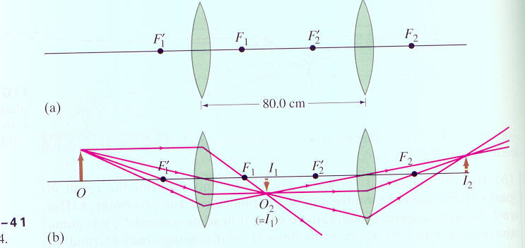
White board example
Combinations of lenses. Two converging lenses, with focal lengths f₁ = 20.0 cm and f₂ = 25 cm are placed 80 cm apart, as shown. An object is placed 60 cm in front of the first lens as shown. Determine (a) the position and (b) the magnification of the final image formed by the combination of the two lenses.

Slide 41
Summary of Geometric Optics Rules
Object distances, p, are typically positive (except e.g., cases of multiple lenses or mirrors with an image on the far side of a lens, or a virtual object behind mirror).
Image distances, q, are positive for real images and negative for virtual images.
Real images form on the same side of the object for mirrors and on the opposite side for refracting surfaces (lenses). Virtual images form on the opposite side of the object for mirrors and on the same side for refracting surfaces.
When an object faces a convex mirror or concave refracting surface the radius of curvature, R, is negative. When an object faces a concave mirror or convex refracting surface the radius of curvature is positive.
Device | Object location | Image location | Image type | Image orientation | Sign of f | Sign of R | Sign of q | Sign of m
Plane mirror | anywhere | opposite object | virtual | same as object | f = ∞ | ∞ | negative | = +1
Concave mirror | outside f | same | real | inverted | positive | positive | positive | negative
Concave mirror | inside f | opposite | virtual | same | positive | positive | negative | positive
Convex mirror | anywhere | opposite | virtual | same | negative | negative | negative | positive
Converging lens | outside f | opposite | real | inverted | positive | positive | positive | negative
Converging lens | inside f | same | virtual | same | positive | positive | negative | positive
Diverging lens | anywhere | same | virtual | same | negative | negative | negative | positive

Slide 42
Imperfect Imaging (Aberrations)
With the exception of flat mirrors, all imaging systems are imperfect.
Spherical aberration is primarily concerned with the fact that the small angle approximation is not always valid.
F
Chromatic Aberration refers to the fact that different colors refract differently
F
Both effects can be lessened by using combinations of lenses
There are other, smaller effects as well

Slide 43
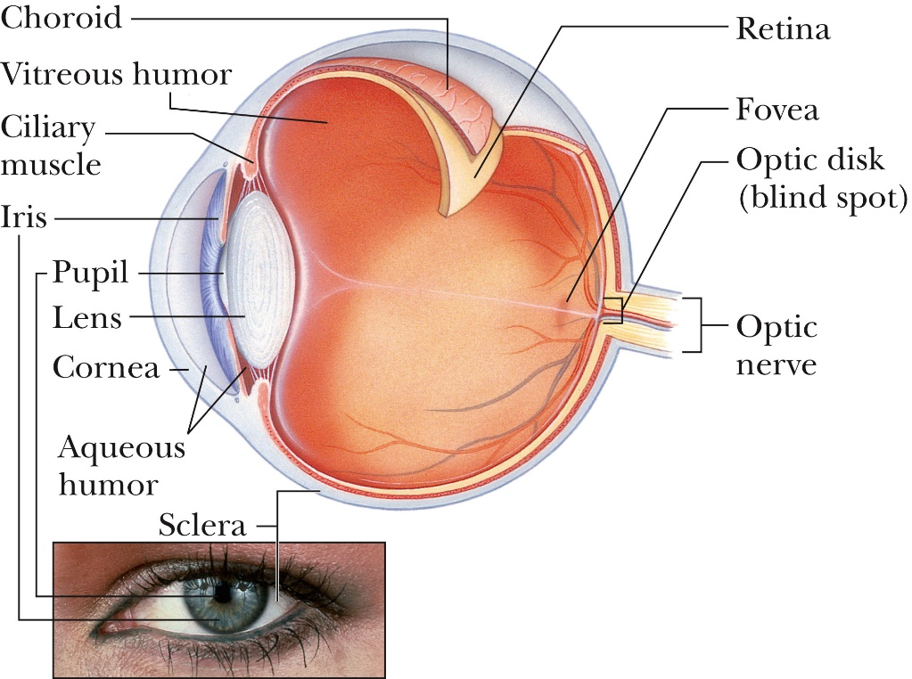
Eyes and Glasses (corrective lenses)
The eye is a physical wonder, but can also be analyzed via geometric optics:
Light enters through cornea (gets refracted), and falls then on an adjustable lens.
Adjustable lens (can change thickness) focuses light on the retina.
Near point: Closest an object can be and still be focused on the retina (~25 cm).
Far point: Farthest an object can be and still be focused on the retina (usually ∞).
Retina is covered with light sensitive cells (rods and cones) that can detect light: Rods detect gray scale (very sensitive), three different kinds of cones detect color.
Iris (colored part of eye) is a muscular diaphragm that controls amount of light (by dilation, contraction)

Slide 44
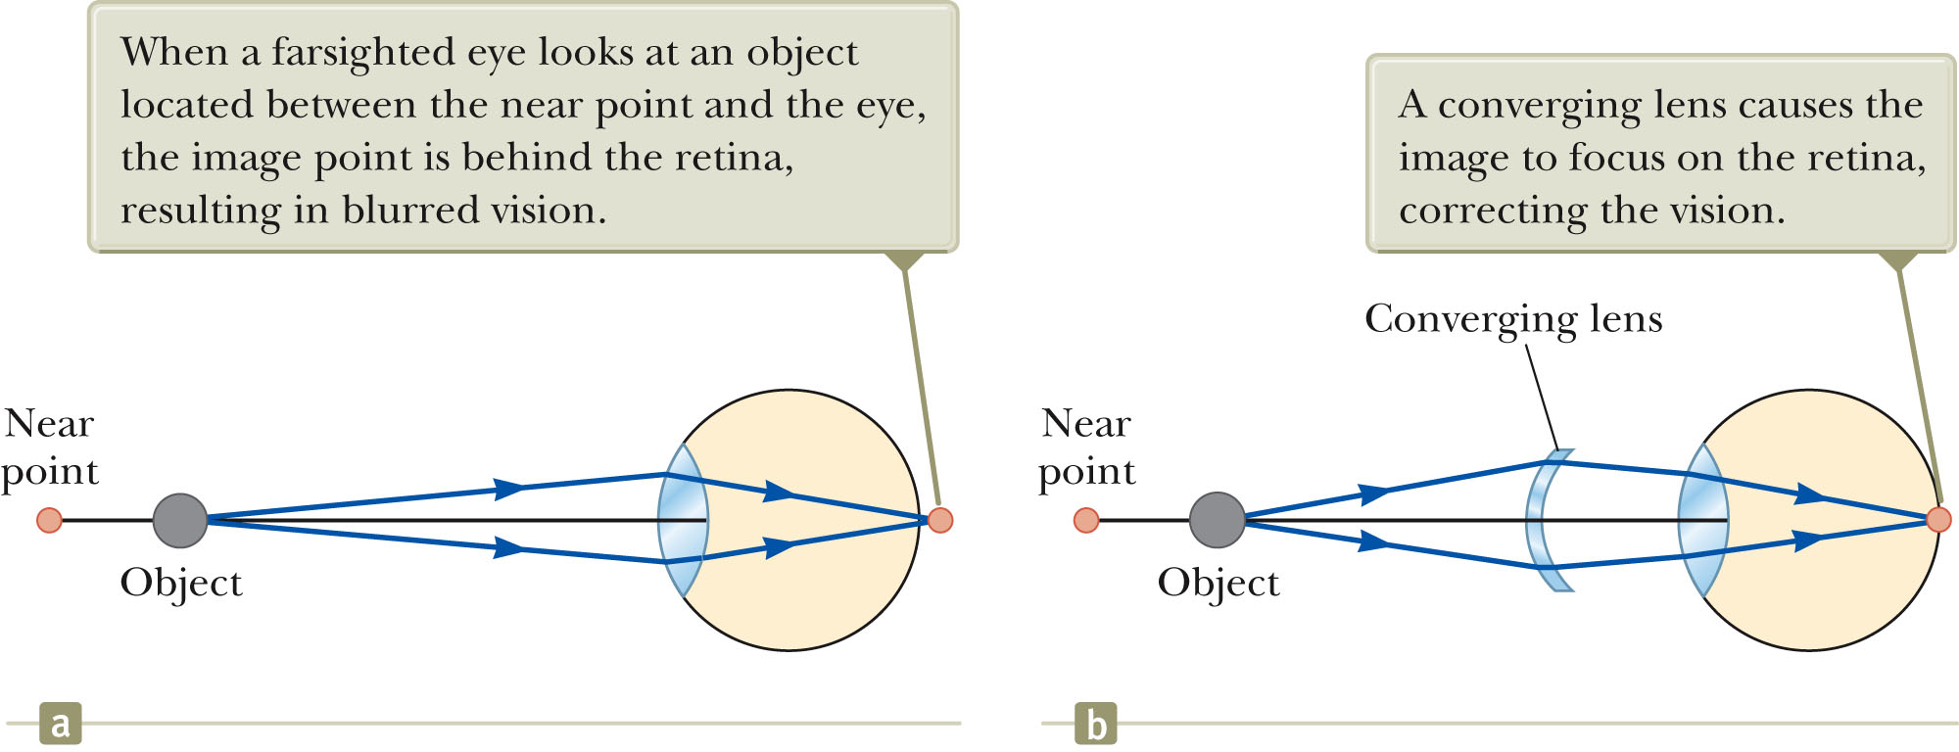
Eyes and Glasses (corrective lenses)
Farsightedness (hyperopica). Vision of far way objects is fine. But the eye is too short and/or the lens is too weak to focus things that are close to the eye onto the retina. Near objects get focused behind the retina.
Can be corrected with a converging lens.

Slide 45
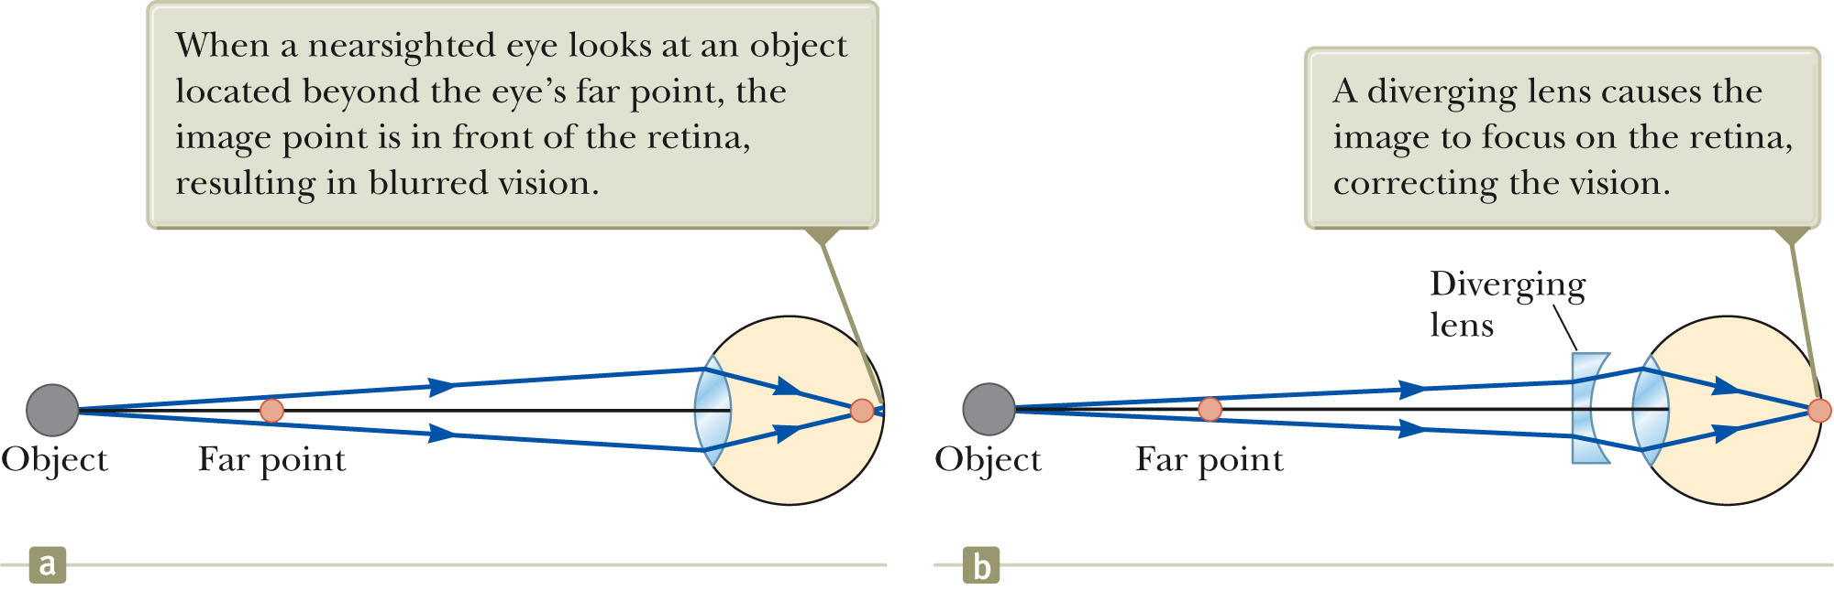
Eyes and Glasses (corrective lenses)
Nearsightedness (myopica). Vision of close objects is fine. But the eye is too long and/or the lens is too strong, so that objects that are far away get focused in front of the retina.
Can be corrected with a diverging lens.

Slide 46


Eyes and Glasses (corrective lenses)
Optometrists usually prescribe lenses measured in diopters:
The power of a lens in diopters, P = 1/f
f is focal lens of lens in meters
A nearsighted person cannot see objects clearly beyond 20.0 cm (her far point).
If she has no astigmatism (points appear as lines) and contact lenses are prescribed for her. What power lens is required to correct her vision?
Is this a diverging or converging lens?

Slide 47
The Microscope
A simple microscope has two lenses:
The objective lens has a short focal length and produces a large, inverted, real image
The eyepiece then magnifies that image a bit more
F_{e}
F_{o}
Since the objective lens can be small, the magnification can be large
Spherical and other aberrations can be huge
    Real systems have many more lenses to compensate for problems
Ultimate limitation has to do with physical, not geometric optics
    Can’t image things smaller than about half the wavelength of the light used
    Visible light 400 - 700 nm, can’t see smaller than about 200 - 350 nm.

Slide 48
Extra Sides

Slide 49
Angular Size & Angular Magnification
To see detail of an object clearly, we must:
    Be able to focus on it (25 cm to ∞ for healthy eyes, usually ∞ best)
    Have it look big enough to see the detail we want
How much detail we see depends on the angular size of the object
θ₀
h
d
Two reasons you can’t see objects in detail:
For tiny objects, you’d have to get closer than your near point
    Magnifying glass or microscope
For others, they are so far away, you can’t get closer to them
    Telescope
Angular Magnification:
how much bigger the angular size of the image is
Goal: Create an image of an object that has
Larger angular size
At near point or beyond (preferably ∞)

Slide 50
The Simple Magnifier
The best you can do with the naked eye is:
      d is near point, say d = 25 cm
Let’s do the best we can with one converging lens
To see it clearly, must have |q| ≥ d
p
h’
h
-q
F
Maximum magnification when |q| = d
Most comfortable when |q| = ∞
    To get high magnification, with d ~ 25 cm, we need small f (lens with short focal length), best magnifying glasses (without too much spherical aberration) have f ~ 5 cm.
    → Magnification is 5x (or less)

Slide 51
Refraction and Images
Now let’s try a spherical surface between two regions with different indices of refraction
Region of radius R, center C, convex in front:
Two easy rays to compute:
Ray towards the center continues straight
Ray towards at the vertex follows Snell’s Law
X
R
n₁
q
h
θ₁
C
Q
P
p
h’
n₂
θ₂
Magnification:
Y

Slide 52
Comments on Refraction
R is positive if convex (unlike reflection)
  R > 0 (convex), R < 0 (concave), R = ∞ (flat)
n₁ is index you start from, n₂ is index you go to
Object distance p is positive if the object in front (like reflection)
Image distance q is positive if image is in back (unlike reflection)
We get effects even for a flat boundary, R = ∞
Distances are distorted:
X
R
n₁
q
h
Q
P
p
n₂
θ₂
Y
No magnification:

Slide 53
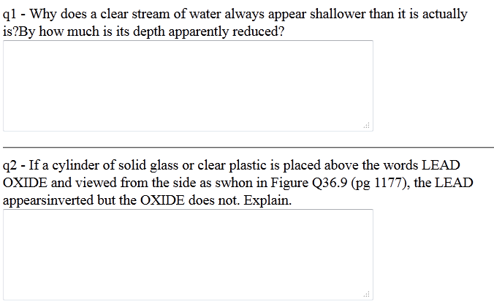

Warmup 25
CG36.16 page 1125

Slide 54

Flat Refraction
A fish is swimming 24 cm underwater (n = 4/3). You are looking at the fish from the air (n = 1). You see the fish
A) 24 cm above the water B) 24 cm below the water
C) 32 cm above the water D) 32 cm below the water
E) 18 cm above the water F) 18 cm below the water
R is infinity, so formula above is valid
Light comes from the fish, so the water-side is the front
Object is in front
Light starts in water
For refraction, q tells you
distance behind the boundary
18 cm
24 cm

Slide 56
Double Refraction and Thin Lenses
Just like with mirrors, you can do double refraction
  Find image from first boundary
  Use image from first as object for second
We will do only one case, a thin lens:
Final index will match the first, n₁ = n₃
The two boundaries will be very close
n₁
n₂
n₃
p
Where is the final image?
First image given by:
This image is the object for the second boundary:
Final Image location:
Add these:
n₁
n₂
n₁

Slide 57
Thin Lenses (2)
Define the focal length:
  This is called lens maker’s equation
Formula relating image/object distances
  Same as for mirrors
Magnification: two steps
Total magnification is product
Same as for mirrors

Slide 58
Using the Lens Maker’s Equation
If f > 0, called a converging lens
  Thicker in middle
If f < 0, called a diverging lens
  Thicker at edge
If you are working in air, n₁ = 1, and we normally call n₂ = n.
By the book’s conventions, R₁, R₂ are positive if they are convex on the front
You can do concave on the front as well, if you use negative R
  Or flat if you set R = ∞
If you turn a lens around, its focal length stays the same
If the lenses at
right are made of
glass and are used
in air, which one
definitely has f < 0?
Light entering on the left:
We want R₁ < 0: first surface concave on left
We want R₂ > 0: second surface convex on left
D
A
B
C

Slide 59
Lenses and Mirrors Summarized
The front of a lens or mirror is the side the light goes in
 | R > 0 | p > 0 | q > 0 | f
mirrors | Concave front | Object in front | Image in front
lenses | Convex front | Object in front | Image in back
Variable definitions:
f is the focal length
p is the object distance from lens
q is the image distance from lens
h is the height of the object
h’ is the height of the image
M is the magnification
Other definitions:
q > 0 real image
q < 0 virtual image
M > 0 upright
M < 0 inverted

Slide 60
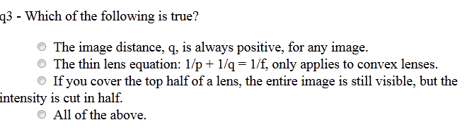
Warmup 25

Slide 61
Solve on Board

Slide 62
The Telescope
A simple telescope has two lenses sharing a common focus
The objective lens has a long focal length and produces an inverted, real image at the focus (because p = ∞)
The eyepiece has a short focal length, and puts the image back at ∞ (because p = f)
f_{o}
f_{e}
F
Angular Magnification:
Incident angle:
Final angle:
The objective lens is made as large as possible
  To gather as much light as possible
In modern telescopes, a mirror replaces the objective lens
Ultimately, diffraction limits the magnification (more later)
  Another reason to make the objective mirror as big as possible
θ₀
θ

Slide 63
Images of Images: Multiple Mirrors
You can use more than one mirror to make images of images
  Just use the formulas logically
Light from a distant astronomical source reflects from an R₁ = 100 cm concave mirror, then a R₂ = 11 cm convex mirror that is 45 cm away. Where is the final image?
5 cm
45 cm
10 cm

Slide 64
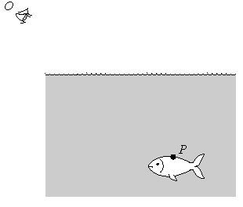
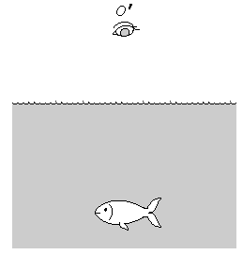
Two more i-clickers
A fish swims below the surface of the water at P. An observer at O sees the fish at
a greater depth than it really is;
the same depth;
a smaller depth than it really is
(For chapter 36). A fish swims below the surface of the water. Suppose an observer is looking at the fish from point O'—straight above the fish. The observer sees the fish at
a greater depth than it really is;
the same depth;
a smaller depth than it really is.

